Slide 1
Optimizing for What? A Vision for ADHD Management in Primary Care
Austin Burns, PhD
IPC Pediatric Psychology Fellow
Nationwide Children’s Hospital

Slide 2
“You do not rise to the level of your goals, you fall to the level of your systems.”
-James Clear, Atomic Habits

Slide 3
IPC and ADHD
Across existing IPC for ADHD models (Shahidullah et al., 2018):
  Greater response to treatment
  Greater reduction in symptoms and other domains of impairment (e.g., social skills, oppositional behavior)
  Behavioral treatment is considered more acceptable by physicians and families
  Access to behavioral treatment is increased

Slide 4
Primary care management of ADHD should optimize for…
Identification of ADHD symptoms and impairment
Equitable access to appropriate, evidence-based interventions, including behavioral health services and medication
Chronic management of ADHD symptoms and impairment

Slide 5
Identifying Symptoms and Impairment

Slide 6
Associated Symptoms/Impairment
Oppositional behavior/defiance
Emotion dysregulation
Social skills deficits/social immaturity
Organizational deficits
School difficulties
Family conflict
Risky behaviors
Sleep difficulties
Mood concerns

Slide 7
Symptom and Impairment Trends (O’Conner et al., 2015)

Slide 8
Optimizing for identification of ADHD symptoms and impairment…
Initial identification and diagnosis through joint visits
  Including behavioral health provider during initial evaluation visits
Using evidence-based questionnaires that capture ADHD symptoms, comorbid symptoms, and impairments
Clinical interviews that elicit parent and child goals (McGoron et al., 2014)
Reassessment of impairments as patients get older

Slide 9
Equitable Access

Slide 10
Access to Behavioral Health Services
~16.5% of children in the U.S. are reported to have at least one mental health disorder (Whitney & Peterson, 2019)
~49.4% of those children did not receive treatment for behavioral health concerns (Whitney & Peterson, 2019)
IPC provides greater access to behavioral health services and these services are generally effective (Asarnow et al., 2015; Burkhart et al., 2020)

Slide 11
Disparities in Access to Health/Behavioral Health Services
Patients of marginalized racial/ethnic backgrounds are less likely to be able to access health services generally (Irvin et al., 2018; Young & Rabiner, 2015)
Also true for behavioral health services broadly (O'Loughlin et al., 2019)
IPC can reduce disparities in access to behavioral health services (Ngo et al., 2009; Hostutler et al., 2023; Shahidullah et al., 2023)

Slide 12
Access to Evidence-Based Care for ADHD
Access to evidence-based diagnosis and treatment of ADHD is inconsistent in primary care (Epstein et al., 2014)
31% of families report receiving behavioral treatment whereas 91% report receiving medication for ADHD (Danielson et al., 2018)
Families of marginalized racial/ethnic backgrounds are less likely to access ADHD services (Eiraldi et al., 2006; Slobodin & Masalha, 2020)

Slide 13
ADHD-Specific Disparities
Parents are more likely to have psychopathology, including ADHD (Cheung & Theule, 2016)
ADHD-related stigma is alive and well and can impact treatment follow-through (Mueller et al., 2012)
IPC can help increase access to ADHD services specifically (Moore et al., 2018; Shahidullah et al., 2018)

Slide 14
Optimizing for equitable access to appropriate, evidence-based interventions …
Evidence-based interventions for management through intentional joint visits
  2-4 guaranteed joint visits initially at ADHD follow-up
    General foundational interventions
      Education, behavioral strategies, navigating school supports, medication
    Specific to family goals
Appropriate medication titration
Higher level of care when appropriate
  E.g., co-located Complex ADHD pathway

Slide 15
Chronic Management

Slide 16
Patterns of Chronicity
Sibley et al. (2016) found that 60% of individuals have symptom persistence into adulthood; 41% met criteria for symptoms and impairment in adulthood
Sibley et al. (2022) found that 63.8% of individuals experience patterns of remission and recurrence over-time; overall 90% of children in the MTA study maintain residual symptoms into young adulthood

Slide 17
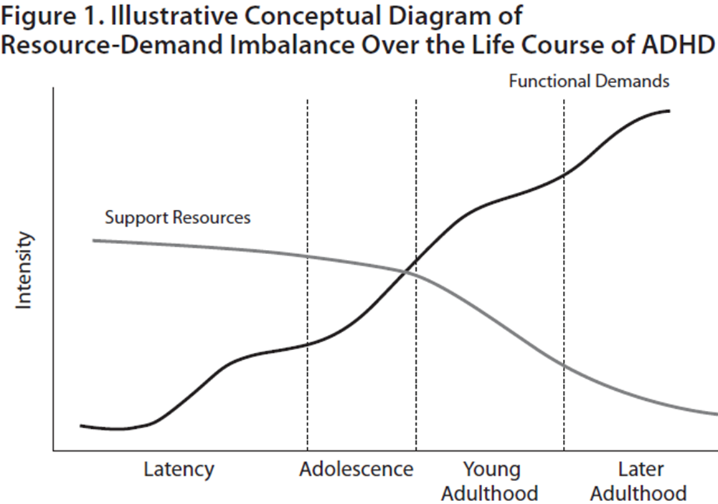
Lifespan Persistence
Turgay, A., Goodman, D. W., Asherson, P., Lasser, R. A., Babcock, T. F., Pucci, M. L., & Barkley, R. (2012). Lifespan persistence of ADHD: the life transition model and its application. The Journal of clinical psychiatry, 73(2), 192-201.

Slide 18
The Changing Face of ADHD
Symptoms can seem to appear in adolescence
Symptoms can change during adolescence
  Often see a shift from more hyperactive symptoms to inattentive symptoms
  Hyperactive/impulsive symptoms look different too!
    runs or climbs -> internally feeling restless
    leaving seat when expected to sit -> going to the bathroom more often (excuse to get up and move)

Slide 19
*Unique Teen ADHD Impairments
Peer and Romantic Relationship Difficulty (McQuade, 2020)
  Less intimacy, less satisfaction, more negative interactions
  Peer rejection/victimization, lack of dyadic friendships, ineffective social skills (can be lack of learning and/or lack of use of social skills)
Risky Behaviors (Garner, 2020; Kennedy et al., 2020; McQuade, 2020)
  Increased risk of substance misuse, risky sexual behaviors, risky driving
Sleep disturbances (Mulraney et al., 2020)
  Difficulty with onset, overall duration, quality, daytime sleepiness
  ADHD symptoms -> Poor sleep -> more ADHD symptoms -> worse sleep (and on and on we go)
* These concerns are not necessarily only experienced by teens, but are particularly salient in teen populations

Slide 20
Optimizing for the chronic management of ADHD symptoms and impairment…
Joint visits at key transition points
  School transitions (Langberg et al., 2008), driving, etc.
Chronic self-management
  Education and understanding of ADHD
Follow-up visits for medication management and regular reassessments of impairment and symptoms

Slide 21
Example: ADHD and Driving
ADHD symptoms are associated with driving risk (Auden et al., 2015; Auden et al., 2018; Curry et al., 2017; Vaa, 2014)
Changing the family climate (i.e., feedback, commitment, communication) around road safety can improve driving outcomes for youth with ADHD (Burns et al., 2022)

Slide 22
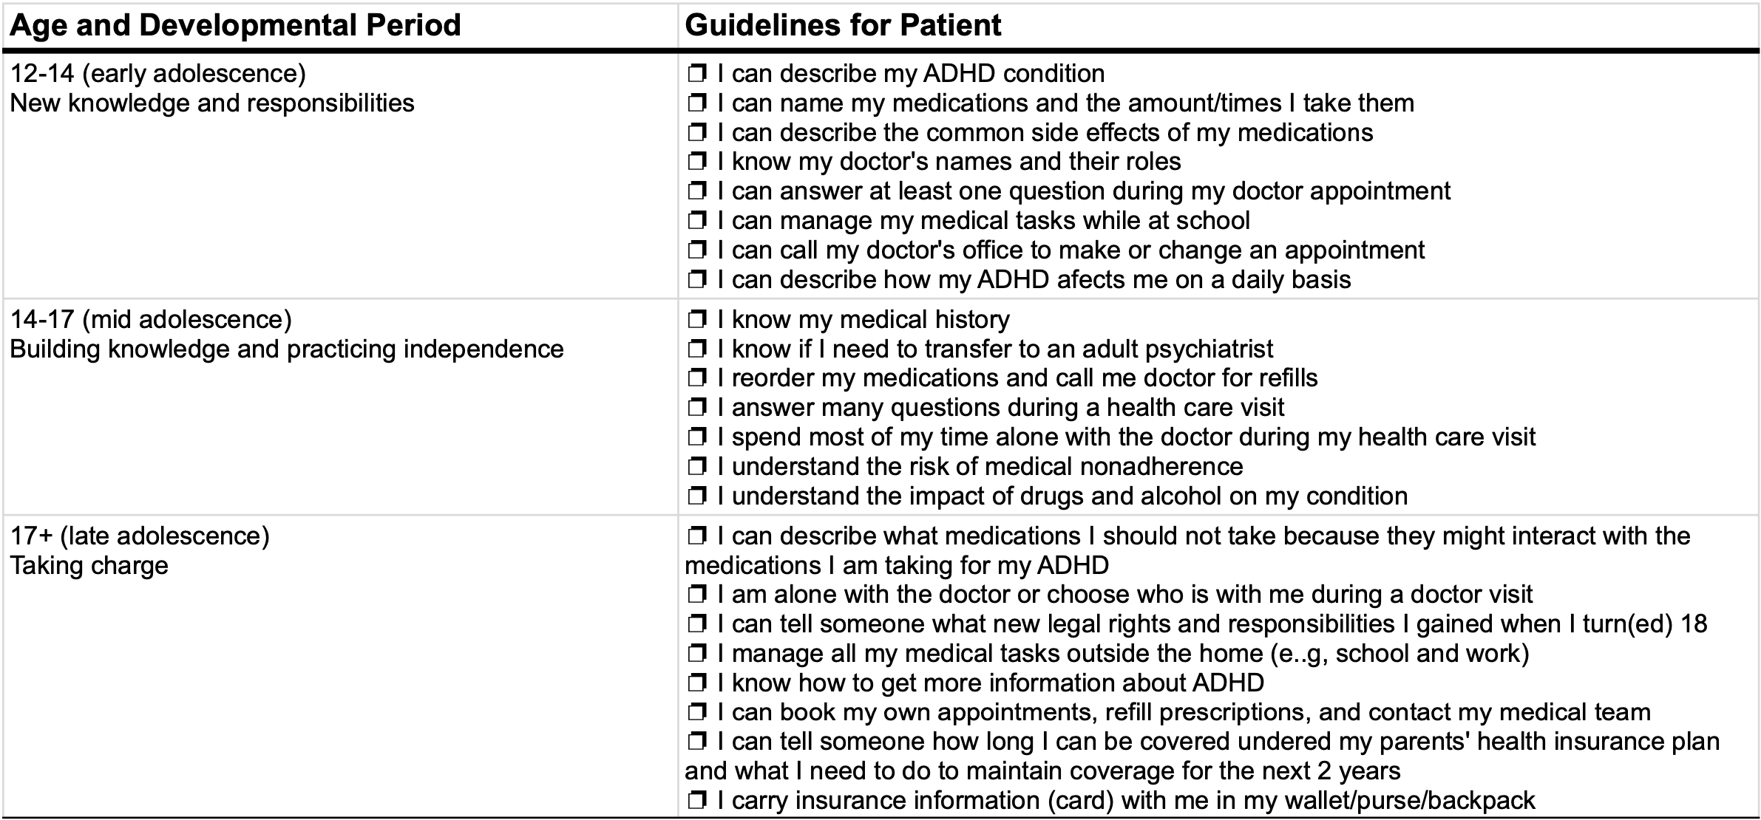
Example: ADHD Transition Checklist

Slide 23
Primary care management of ADHD should optimize for…
Identification of ADHD symptoms and impairment
Equitable access to appropriate, evidence-based interventions, including behavioral health services and medication
Chronic management of ADHD symptoms and impairment

Slide 24
Thank you!
Questions?

Slide 25
Credits for Slide Template
Special thanks to all the people who made and released these awesome resources for free:
Presentation template by SlidesCarnival
Photographs by Unsplash

